Slide 1
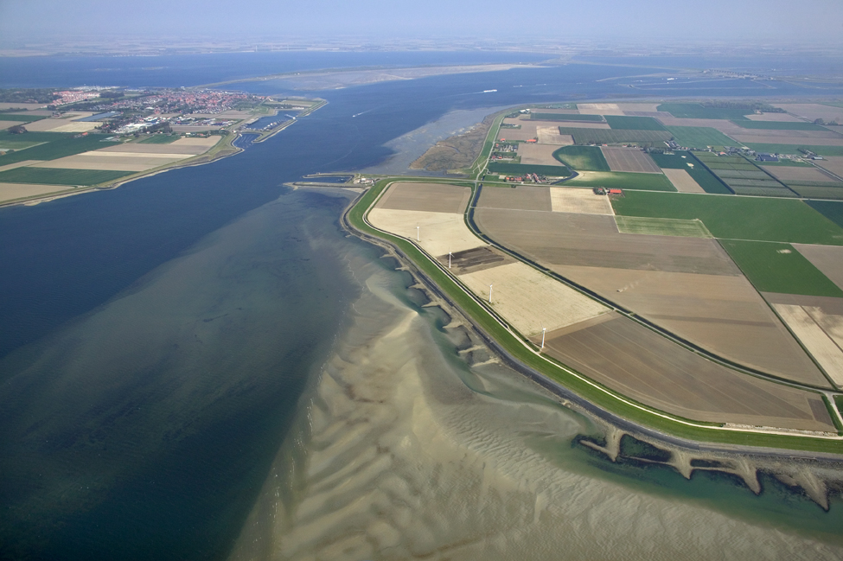


Delft-FEWS
Basic Configuration Course
(continued)
Notes:
Live System Aspects
Organising the live system
Components of a live system
Workflows - Running
Workflows – Scheduling
Triggered Workflows (het principe)
(Synchronisation)
Tool – Admin Interface:
Health Checking/Status Information
Workflow Load Balancing (mapping)
Workflow Overview (Scheduled Tasks)
Scheduling
Configuration
Configuration Manager
How Config Files/Patches are being distributed?
Optimizing the Live System
Monitoring
Configuration aspects (expiry time, synchLevel, valueResolution)
Maintenance Workflows
Amalgamate
Database Analysis
Advanced
Multi MC Systems
Duty-standby
Event-action configuration

Slide 2


Live systems

Slide 3
Table of contents
Live system aspects
components,
workflows and
synchronisation

Slide 4
Stand-alone vs Live
During the course we have been using a stand-alone application of Delft-FEWS. We will now discuss various elements of a live (client-server based) Delft-FEWS system.
stand alone

Slide 5
Components - Delft-FEWS system overview
server
clients
forecasting shell(s)
forecasting shell(s)
operator client
FSS
FSS
OC
operator client
master controller
&
central database
OC
MC
operator client
OC

Slide 6
Running a workflow: import (external) data
server
forecasting shell(s)
User logs in and start import run
Task is dispatched to FSS
FSS synchronises all data (gets up to date with central database)
FEWS reads/parses all data(feeds)
FEWS stores data in local (FSS) database
FSS synchronises new data to central database
Clients receives latest (import) data
4
data
fews
model
5
messages/tasks
2
FSS
data
6
client(s)
3
master controller
central database
operator client(s)
MC
CDB
7
OC
1

Slide 7
Running a workflow: model run
server
forecasting shell(s)
User logs in and start model run
Task is dispatched to FSS
FSS synchronises all data (gets up to date with central database)
FEWS exports input data for model (PI-XML or NetCDF)
Model adapter converts to native input
Model executes and produces native output
Model adapter converts native output to PI-XML or NetCDF
FEWS imports output data from the model
FSS synchronises new data to central database
Clients receives latest (model) data
8
7
data
fews
model
4
5
6
messages/tasks
2
FSS
data
9
client(s)
3
master controller
central database
operator client(s)
MC
CDB
10
OC
1

Slide 8
Communication between components: JMS
Role of JMS
Primary communication between components; holds the system together..
MC-MC communication
Internal within an MC
(Between remote MCs)
MC-FSS communication
Synchronisation of data
Launching / management of task runs
MC-OC communication
Synchronisation of data
Log in / session messages
Note: Clients connect to the JMS providers, not the MC server(s)…

Slide 9
Synchronisation - Delft-FEWS system overview
server
clients
forecasting shell(s)
forecasting shell(s)
operator client
FSS
FSS
OC
operator client
master controller
&
central database
OC
MC
operator client
Data exchange between components is called synchronisation (party configurable)
OC

Slide 10
Synchronisation - FSS
Forecasting Shell(s)
at startup (downloading)
build DB from scratch (new system, DB deleted)
before a task (downloading)
latest config
latest data
after a task (uploading)
created data

Slide 11
Synchronisation - OC
Operator Client
at startup (downloading) / at login
build DB from scratch (new system, DB deleted)
configuration
data
“on line”
at certain intervals (configured)
data
configuration
when a forecast is approved (by somebody else/system)

Slide 12
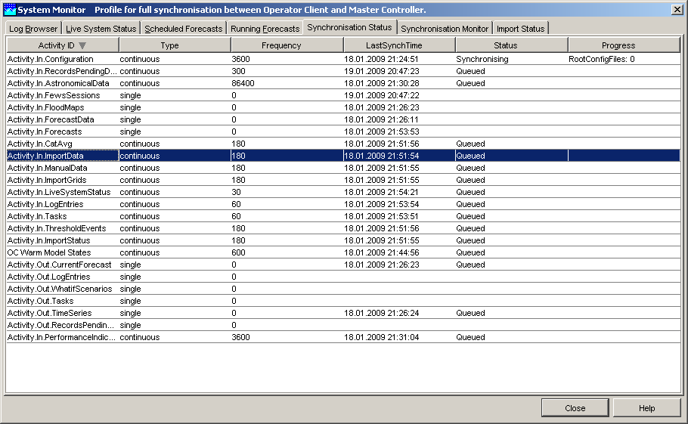
Synchronisation in FEWS
The FEWS OC local datastore is retrieving data from the central database
through synchronisation (using JMS)
synchronisation is using synchronisation activities

Slide 13
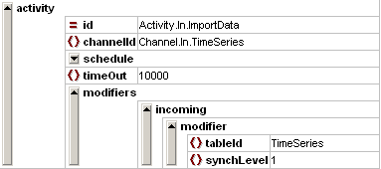
Synchronisation in FEWS
The FEWS OC local datastore is retrieving data from the central database
through synchronisation (using JMS)
synchronisation is using synchronisation activities
time series are synchronised through several activities
Activity.in.Importdata
Activity.in.CatAvg
Activity.in.ImportGrids
Activity.in.Astronomicaldata
the time series activities use the synchLevel element of the timeSeriesSet

Slide 14
Synchronisation activities
Synchronisation Activities (mostly decribing for recognition)
frequency
which ‘Channel’
SynchChannels
table
exceptions/modifiers
SynchProfiles (organisation of Channels)
FSS profile
OC
minimum
full
custom
CM

Slide 15
Synchronisation levels
synchLevels – selected by convention
0 (Default) All data from a forecast run
1 Scalar time series imported from telemetry Data transformed using “fixed” relationship (Q-h, correlation)
2 All grid data from a forecast run (e.g. Flood Maps)
3 CatAvg data (forecasts, actuals & NWP)
4 Astronomical
5 Data edited on OC
6 Grid data imported from external forecast (synch. to OC)
7 Grid data imported from external forecast (FSS & MC only)
8 Performance indicators
9 Temporary time series (FSS only)

